Slide 1
BitCoin & Blockchains
C.3 Case Study

Slide 2

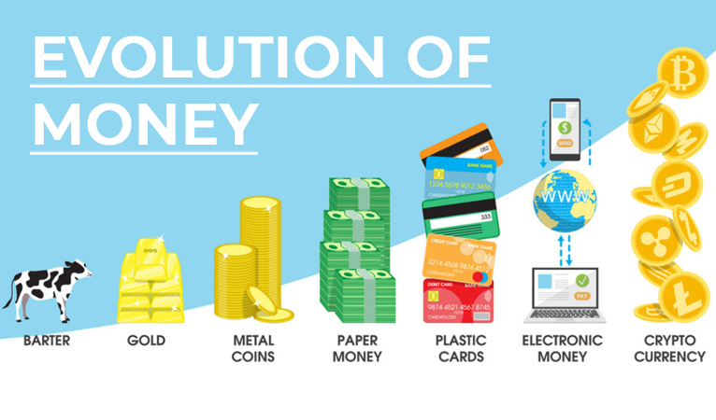
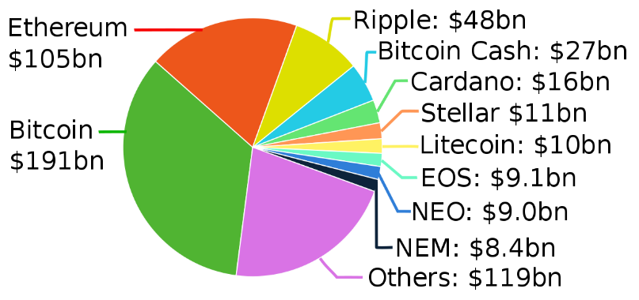
BitCoin & Crypto-Currencies
BitCoin is only on of many Crypto-Currencies
Big companies and governments are now getting involved
Crypto-Currency is the future of money
It is not a trend that is only for limited on-line applications

Slide 3
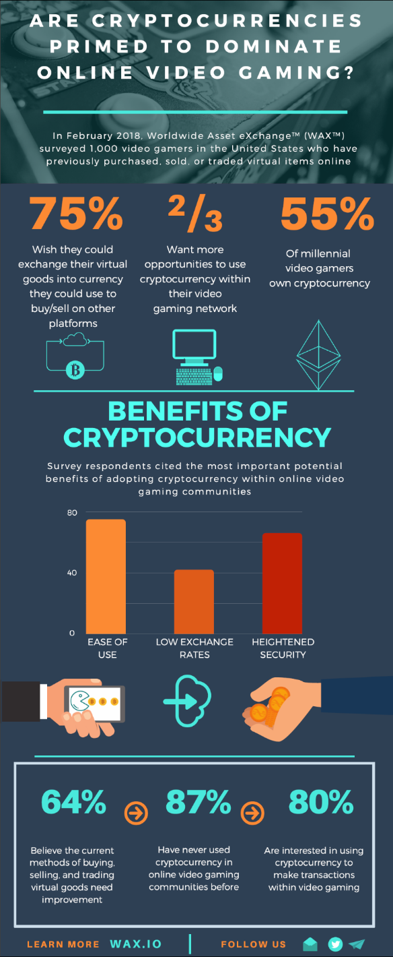
Crypto-Currencies Uses
Benefits & Advantages:
Security
Secrecy (Confidentiality)
Ease of Use
No Central Ownership / Manipulation
Use for Traditional Transactions is Expanding
Not limited to On-Line
Paying Taxes (Markham Ont.)
Realestate Agents (PSR Brokerage Toronto)

Slide 4
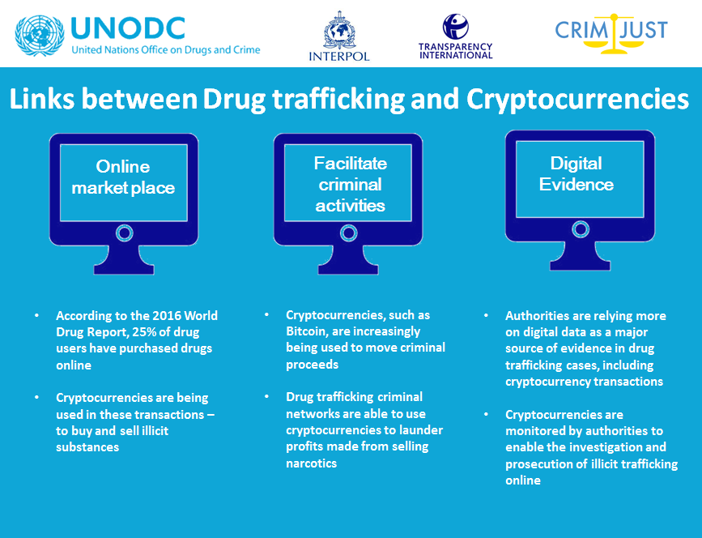
BitCoin & Criminals
Crypto-Currencies in the News:
BitCoin and Ransomware Attacks
BitCoin and Organized Crime
BitCoin and Corrupt Governments
Note: Media Needs To Sell Stories
New Ideas always get negative press
What about all the crime using traditional money?
BitCoin Has Many Disadvantages For Criminals
BitCoin transactions can be traced
All BitCoin transactions are recorded and are publically accessible

Slide 5
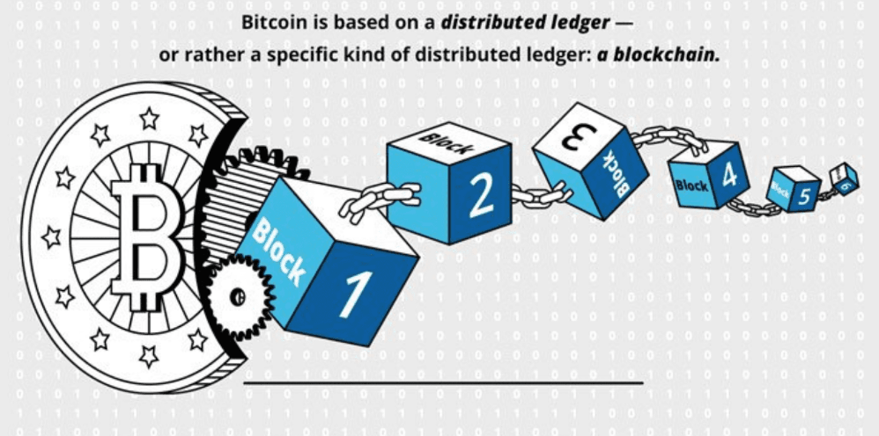
BitCoin & Blockchains
Blockchain Technology is at the heart of Crypto-Currencies
Each transaction is added to a block
Each BitCoin has a chain of blocks that record its history
The blocks are encrypted so that they cannot be faked or altered
Encryption requires a lot of computer processing power

Slide 6
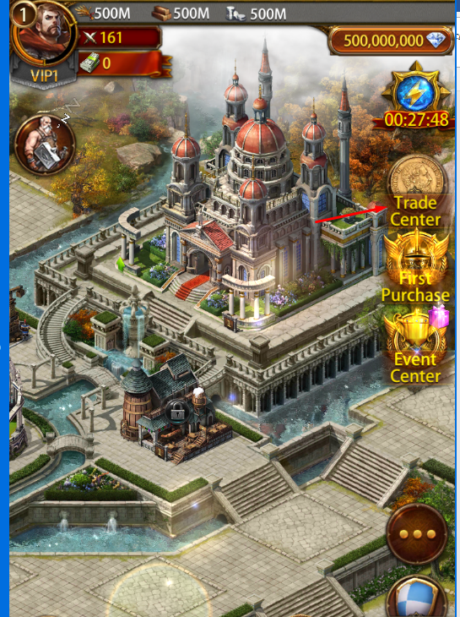
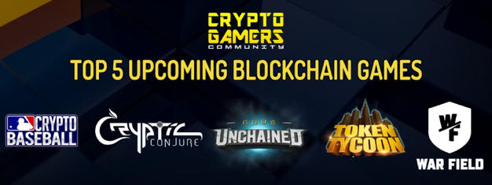
Other Uses For Blockchains
Crypto-Games
Future of On-Line Gaming
Replace In-App Purchases
Playing the game generates Crypto-Currency. (Top Games Inc. produce TopCoin)
Retail & Manufacturing
Tracking salad kits to prevent food poisoning (Loblaws)
Tracking aircraft parts to detect fake knock-offs (Air Canada)

Slide 7
BitCoin Mining
t.b.d.

